Slide 1

BUSINESS ANALYTICS CLUB
Workshop Series 9.12
Principles of Data Mining
Applications in Consulting
Janet Ye
Shantanu Joshi

Slide 2
Set Ups
Download the zip file from bit.ly/bacdata “Weka Consulting” folder. In the zip file, you’ll find:
Weka installer
PC: weka-3-6-13jre.exe
Mac: Weka-3-6-12-oracle-jvm.app
Installation Guide
Data set
Notes:
Shinu fix
Thinking about just doing one pdf outlining all the steps of installation

Slide 3
Learning Objective
Understand Data Mining and learn the use cases in various industries
Present the problem, and approach the consulting case as a data consultant
Introduce most common algorithms:
J48 Trees
Logistic Regression
k Nearest Neighbors (kNN)
Formulate a proposal to the case

Slide 4
Data Science? Data Mining?
Data science: set of fundamental principles that guide the extraction of knowledge from data
Data mining: the act of extracting knowledge from data, via technologies that incorporate these principles
Data Science and data mining have nothing to do with acquisition of the data!

Slide 5
Solving Business Problems
NYU Langone – benign or cancerous tumor?
Apple – increase profit from the iPad Pro?
Macy’s –bundling items?
Verizon – cell phone usage profiling?
Google – natural language processor for searching?
Facebook / LinkedIn – friends you may know?
Amazon / Netflix / Spotify – product recommendations?

Slide 6
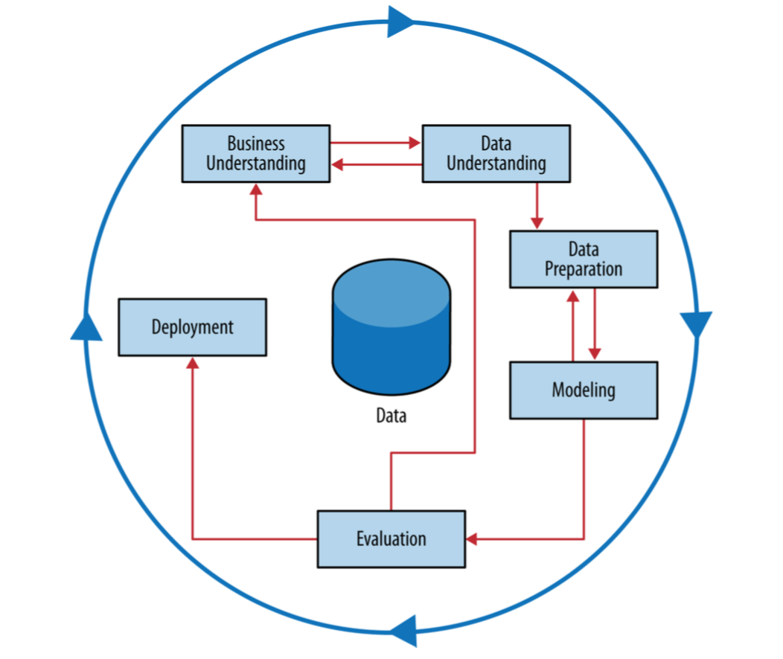
Data Mining Cycle

Slide 7
Business Understanding
Your client is an auto dealer that buys used cars from auctions and repairs them for resale. Recently, the firm has been purchasing a record amount of cars. A lot of these cars turned out to be lemons, and the firm’s profits have been going down.
What can you do for the firm?

Slide 8
Data Understanding
The firm says it has a large cache of data on each car, and which cars have been lemons
An average consultant would do something like:
Segment the data by car type / make / model
Might use Excel, plot some graphs, and make assumptive statements on probabilities of certain segments
How do we do better?
As a data consultant, we can use data mining techniques to build a classification model (good cars vs. lemons)

Slide 9
Data Understanding (ctd)
Example variables:
auction info
vehicle year
vehicle age
make
color
transmission
wheel type
etc.
Notes:
Is it necessary to introduce word of caution now?

Slide 10
Data Preparation
Weka accepts .arff files
See appendix for converting a .csv to .arff file
Notes:
Is it necessary to introduce word of caution now?

Slide 11
Modeling
Target variable (y)
Features (x)
Instance: feature + target (x, y)
Supervised
Develop a model using an example dataset with both features and target variable, called training set
Example: have dataset on cars and whether they were good or lemons. How to better classify?
Unsupervised
Build a model using a dataset with only the features, no target variable
Example: find patterns in data with no objectives
Notes:
Is it necessary to introduce word of caution now?

Slide 12
Today we focus on three models.
Notes:
Is it necessary to introduce word of caution now?

Slide 13
J48 (Decision Tree)
Divide the data using the most informative attribute into two sets/branches
Subdivide the sets using other variables as many times as we would like
Finally, group the instances into good cars vs. lemons using a chosen metric
Notes:
show the tree in weka

Slide 14
kNN (k Nearest Neighbor)
Form groups of k instances/neighbors
To predict a new instance, we find its “nearest” neighbors
Notes:
show the tree in weka

Slide 15
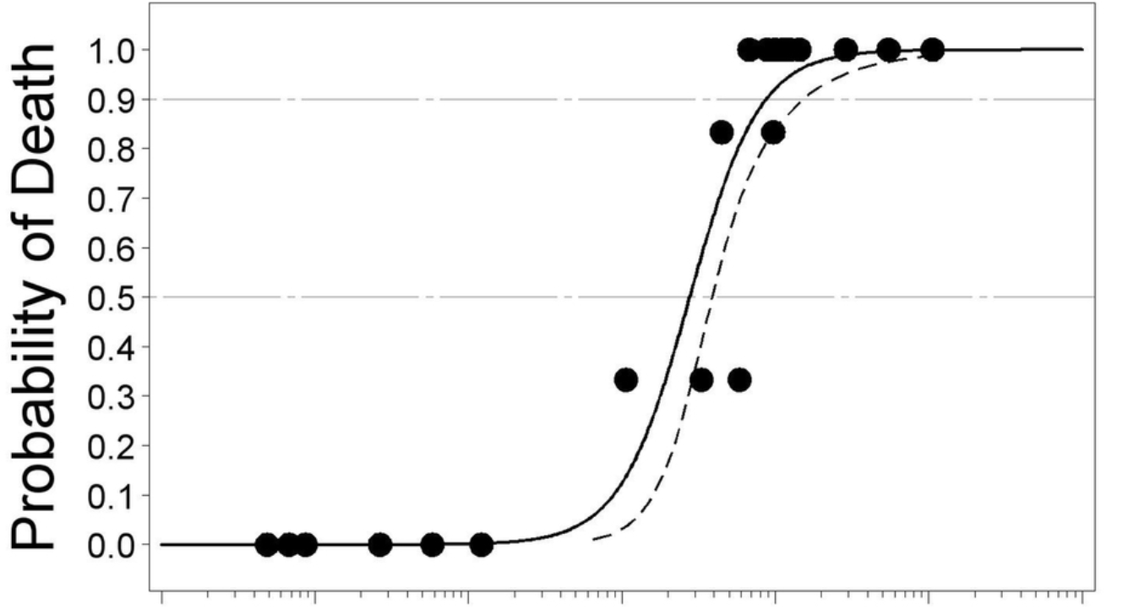
Logistic Regression
Fits a “sigmoid” curve to a special data set with a threshold separating the two cases in a binary outcome
Examples
young vs. old smokers having cancer
good cars vs. lemons
Notes:
show the tree in weka

Slide 16
Finding the Best Model
The metric we use to define “best” is AUC –area under receiver operating characteristic (ROC) curve
Target variable is assigned as:
good car = 0, lemon = 1
AUC area is the probability that a randomly chosen lemon ranks higher than a randomly chosen good car
Perfect model = 1
Random model = 0.5
0 < bad model < 0.5
Notes:
show the tree in
Task: for each model, fit multiple complexity parameters to get AUC
weka

Slide 17
Finding the Best Moel
To generate AUC, we adjust the complexity parameter for each model (how simple or complicated a model is)
Tree – minimum number of objects in a leaf (minNumObj)
Simpler model = fewer branches
If minNumObj is a large number, we have a lot of instances in one leaf, thus few branches
Logistic Regression – Ridge parameter
Simpler model = larger ridge
kNN – adjust k
Simpler model = larger k
If k large, group a lot of instances in one neighborhood, fewer clusters
Notes:
Task: for each model, fit multiple complexity parameters to get AUC

Slide 18
J48 Complexity
Click [Explore]
Open [File]
Choose [car_data.arff]
Change to [Classify] tab
Click [Choose] under classifier
Under [Trees] look for [J48] and click
Click the text that says [J48 –C 0.26 –M 2]
A dialogue box should open with options
Here we can adjust settings of model
Change [Unpruned] to [True]
[minNumObj] to 2
Notes:
show the tree in weka

Slide 19
J48 Complexity
Under [Test Options], select [Percentage Split] and make sure it is set to [66%]
Make sure the dropdown menu under [Test Options] has [(Nom) IsBaBuy]
Click [Start]
In the output, scroll down to [Detailed Accuracy by Class]
Under wich you will find the AUC for this model (in this case 0.636)
Save this value in a table
Increase complexity by factors of 2 (2^0, 2^1, 2^2, …, 2^12)
You can stop when AUC plateaus or hits 0.5
Notes:
show the tree in weka
Word of caution: biggest pitfall in data mining is overfitting
building a model that fits well to the dataset but fails to generalize
Solution: use 66% of data to build a model, and save 33% to test on

Slide 20
Word of Caution
Note on [Test Options], select [Percentage Split] set to [66%]
The biggest pitfall in data mining is overfitting
Building a model that fits well to the training data but fails to generalize
Solution: 66% split
66% of data, as training set, used for building a model
33% of data, as test set, used for testing the model
Model is judged on how well it performs on test set
Notes:
show the tree in weka
Word of caution: biggest pitfall in data mining is overfitting
building a model that fits well to the dataset but fails to generalize
Solution: use 66% of data to build a model, and save 33% to test on

Slide 21
Complexity by Models
numMinObj | J48 | Ridge | Logistic | Complexity | kNN
2 | 0.636 | 1e-4 | 0.761 | 4 | 0.691
4 | 0.660 | 1e-2 | 0.761 | 8 | 0.713
8 | 0.702 | 0.1 | 0.761 | 16 | 0.732
16 | 0.714 | 1 | 0.761 | 32 | 0.739
32 | 0.719 | 10 | 0.762 | 64 | 0.741
64 | 0.733 | 100 | 0.762 | 128 | 0.735
128 | 0.729 | 1,000 | 0.757 | 256 | 0.740
256 | 0.735 | 10,000 | 0.738 | 512 | 0.737
512 | 0.721 | 100,000 | 0.726 | 1024 | 0.734
1024 | 0.719 | 1,000,000 | 0.724 | 2048 | 0.726
2048 | 0.661 |  |  | 4096 | 0.706
4096 | 0.500 |  |  | 8192 | 0.500
8192 | 0.500
Notes:
show the tree in weka

Slide 22
Best model is Logistic Regression, Ridge = 100
Now what?

Slide 23
Working with Best Model
Go back to weka [Explore], click [Choose] under [Classifier] tab
Under [Functions], look for [logistic]
Click the text [Logistic –R 1.0E-8 –M -1]
Select [Percentage Split], make sure [66%] is the test method
Click [More Options…] under [percentage split]
Select the box for [Output Predictions]
Now if you scroll up in [Classifier Output], you’ll see probabilities for each instance of being a 0 or 1
Notes:
show the tree in weka
Word of caution: biggest pitfall in data mining is overfitting
building a model that fits well to the dataset but fails to generalize
Solution: use 66% of data to build a model, and save 33% to test on

Slide 24
Working with Best Model
We can copy and paste these into Excel and start analyzing them
We did this for you in “car_costs_and_probabilities.xls”
The methodology to do this in the Appendix if you are curious
Notes:
Excel sheet includes costs for a certain car, and prices on the market if not a lemon
Paste in output probabilities from Weka into Excel sheet
Sort by P (not lemon) descending
Calculate expected profit for each instance
Expected profit = Expected Retail Price * P(not a lemon) – cost to buy at auction

Slide 25
Excel Analysis
Excel sheet includes costs for a certain car, and prices on the market if not a lemon
Paste in output probabilities from Weka into Excel sheet
Sort by P (not lemon) descending
Calculate expected profit for each instance
Expected profit = Expected Retail Price * P(not a lemon) – cost to buy at auction
Next, calculate cumulative costs
For instance 1, this is just cost at auction
For instance 2, this is cumulative costs in instance 1 + cost to buy instance 2 at auction
Apply second instance formula to rest of the data
Notes:
Excel sheet includes costs for a certain car, and prices on the market if not a lemon
Paste in output probabilities from Weka into Excel sheet
Sort by P (not lemon) descending
Calculate expected profit for each instance
Expected profit = Expected Retail Price * P(not a lemon) – cost to buy at auction

Slide 26
Excel Analysis
Apply the second instance formula to the rest of the data
Calculate cumulative profit
For instance 1, this is just the expected profit
For instance 2, this is cumulative profit at instance 1 + expected profit of instance 2
The graph should automatically adjust
Notes:
Excel sheet includes costs for a certain car, and prices on the market if not a lemon
Paste in output probabilities from Weka into Excel sheet
Sort by P (not lemon) descending
Calculate expected profit for each instance
Expected profit = Expected Retail Price * P(not a lemon) – cost to buy at auction

Slide 27
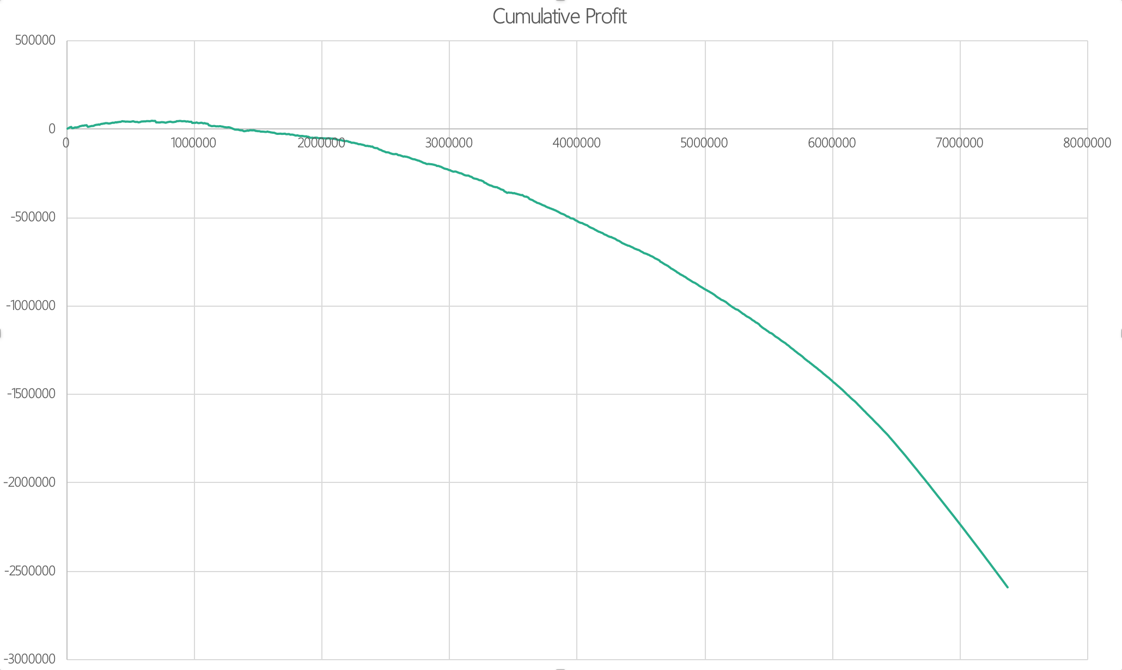
Profit Curve

Slide 28
Profit Curve
Let’s interpret this graph…
If we buy 0 cars, we spend $0 and make $0
If we buy around 172 cars, we spend $1,305707, and make around $1408
Above 172 cars, we start losing money
Purchase too many lemons, cut into profits
Notes:
How many cars should we buy?

Slide 29
How many cars should we buy?
Notes:
How many cars should we buy?

Slide 30
Profit Curve
Ideally, we buy until our profit is maximized
According to our model…
Max profit = $47,858
Car #88
Recommendation: ideal budget is to buy 88 cars, which would cost us around $668,082.
Other consideration: Should take client’s financials into account
Notes:
How many cars should we buy?

Slide 31
Deployment
Let’s take this to our Clients
Interpret
Ask client to extend engagement
Collect data on next 88 purchases and re-evaluate model

Slide 32
Useful Resources
Free Stanford Machine Learning on Coursera
Link: https://www.coursera.org/learn/machine-learning
Blog with detailed write-ups http://www.holehouse.org/mlclass/index.html

Slide 33
Acknowledgement
Jessica Clark
PhD Candidate, Information,
Operations and Management Sciences

Slide 34
Appendix – Data Prep
For data preparation we remove extraneous elements in excel
Export excel to csv
Use http://ikuz.eu/csv2arff/ to convert csv to arff
Make sure online converter correctly identifies numerical, categorical, and binary variables
Edit the arff file in a text editor to make sure it confines to weka standard

